Slide 1

Artificial Intelligence
Mini Project

Slide 2
Neural Network from Scratch
Made By-
DAKSH PATEL RA1911003010519
RITIKA GUPTA RA1911003010524
ARYAN KAPOOR RA1911003010537

Slide 3
What are Neural Networks
A neural network is a series of algorithms that endeavors to recognize underlying relationships in a set of data through a process that mimics the way the human brain operates. In this sense, neural networks refer to systems of neurons, either organic or artificial in nature.
Neural networks can adapt to changing input; so the network generates the best possible result without needing to redesign the output criteria. The concept of neural networks, which has its roots in artificial intelligence, is swiftly gaining popularity in the development of trading systems.

Slide 4
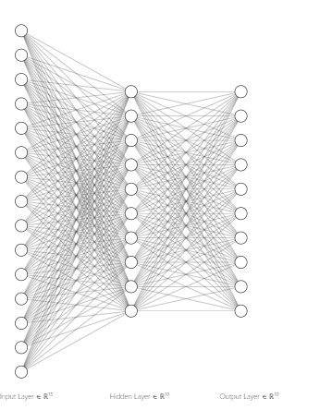
Architecture
About
Input neurons: 784
Hidden layer 1 Neurons: 10
Output Layer Neurons: 10

Slide 5
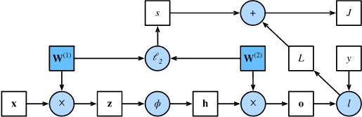
Forward Propagation
Forward propagation (or forward pass) refers to the calculation and storage of intermediate variables (including outputs) for a neural network in order from the input layer to the output layer. We now work step-by-step through the mechanics of a neural network with one hidden layer.
Computational graph of forward propagation.

Slide 6
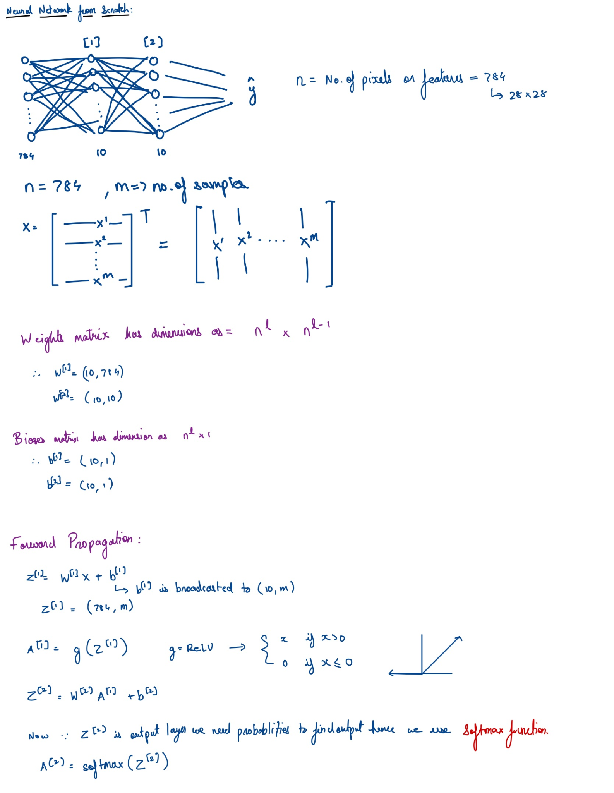
Manual Calculation
for Forward Propagation

Slide 7
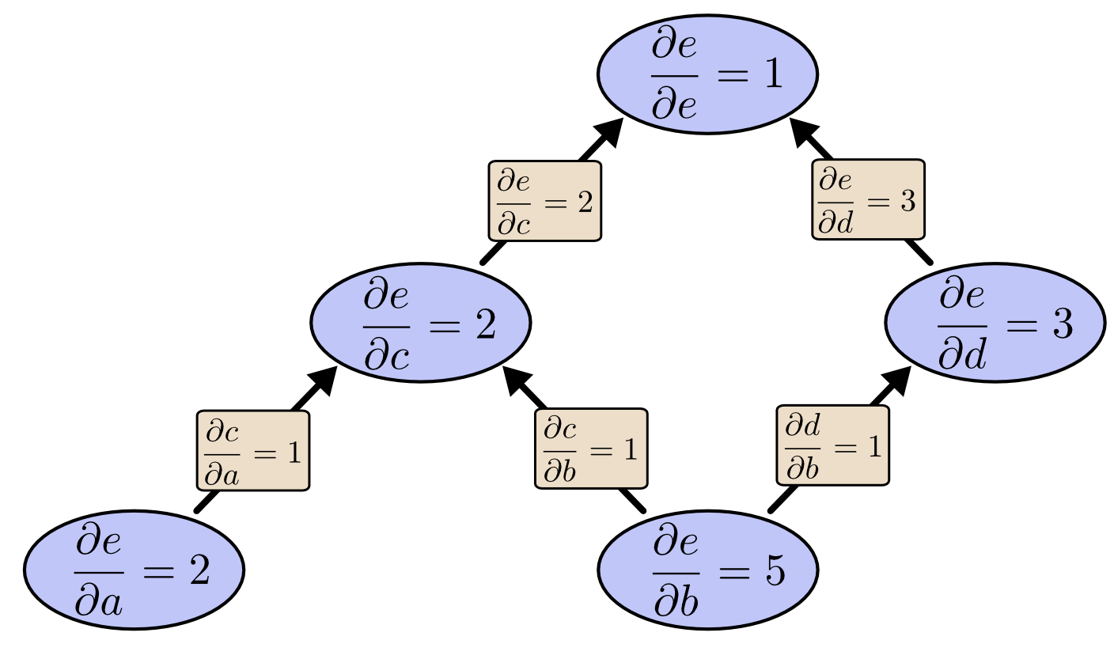
Backward Propagation
Backpropagation refers to the method of calculating the gradient of neural network parameters. In short, the method traverses the network in reverse order, from the output to the input layer, according to the chain rule from calculus. The algorithm stores any intermediate variables (partial derivatives) required while calculating the gradient with respect to some parameters.
Computational graph of backward propagation.

Slide 8
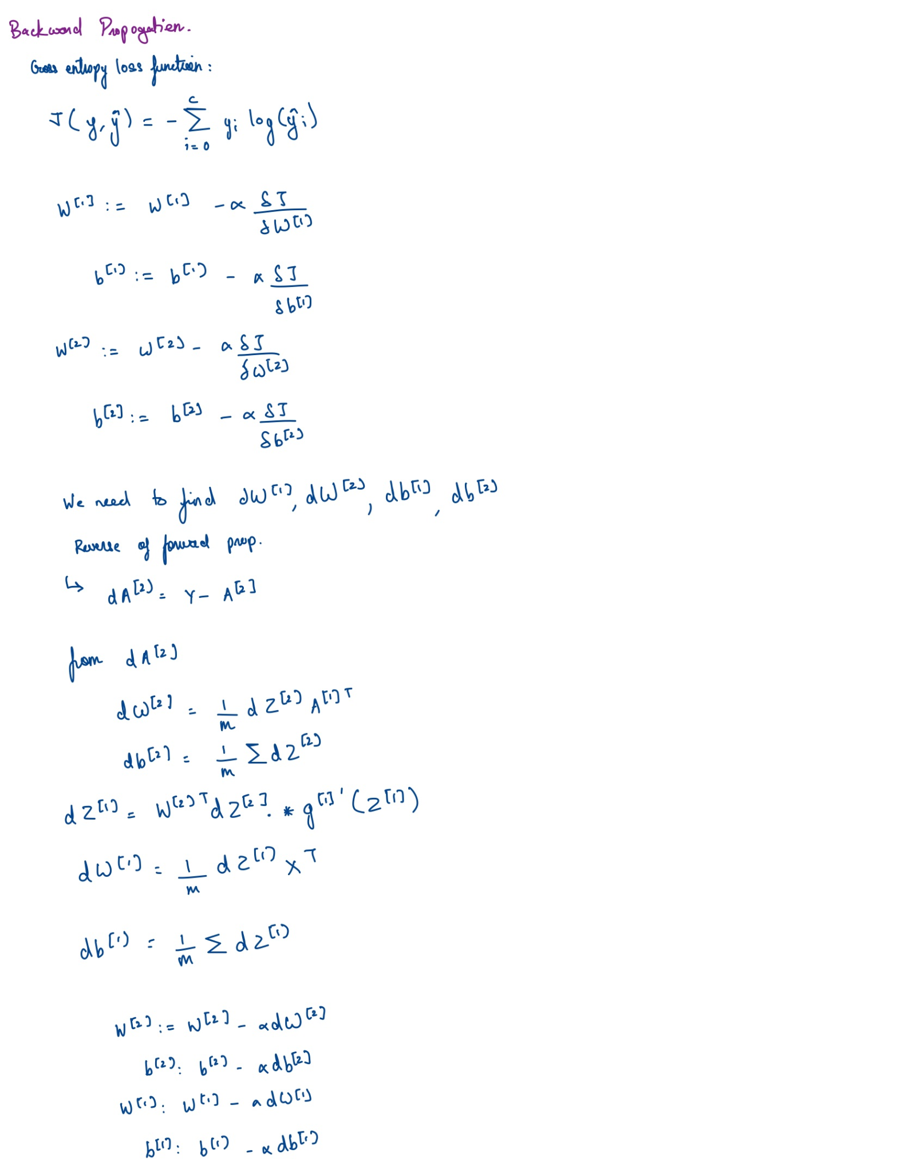
Manual Calculation
for Backward Propagation

Slide 9
Summary
Forward propagation sequentially calculates and stores intermediate variables within the computational graph defined by the neural network. It proceeds from the input to the output layer.
Back propagation sequentially calculates and stores the gradients of intermediate variables and parameters within the neural network in the reversed order.

Slide 10
Gradient descent
Gradient descent (GD) is an iterative first-order optimisation algorithm used to find a local minimum/maximum of a given function. This method is commonly used in machine learning (ML) and deep learning(DL) to minimise a cost/loss function (e.g. in a linear regression). Due to its importance and ease of implementation, this algorithm is usually taught at the beginning of almost all machine learning courses.
However, its use is not limited to ML/DL only, it’s being widely used also in areas like:
control engineering (robotics, chemical, etc.)
computer games
mechanical engineering

Slide 11
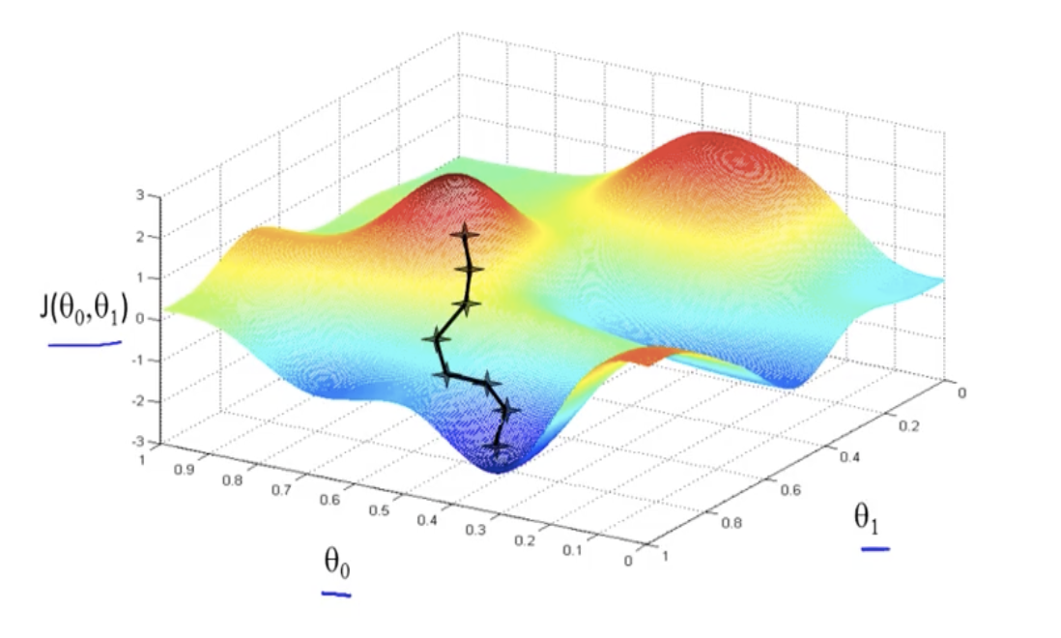
Gradient descent

Slide 12
Conclusions
In predicting handwritten digits we were able to get an accuracy of 83.96%.

Slide 13
References
Machine Learning course from Stanford University by Andrew NG
Deep learning course by Andrew NG
Intuitive Neural Networks: Understanding and building NN models | by Gokul S Kumar | Towards Data Science

Slide 14
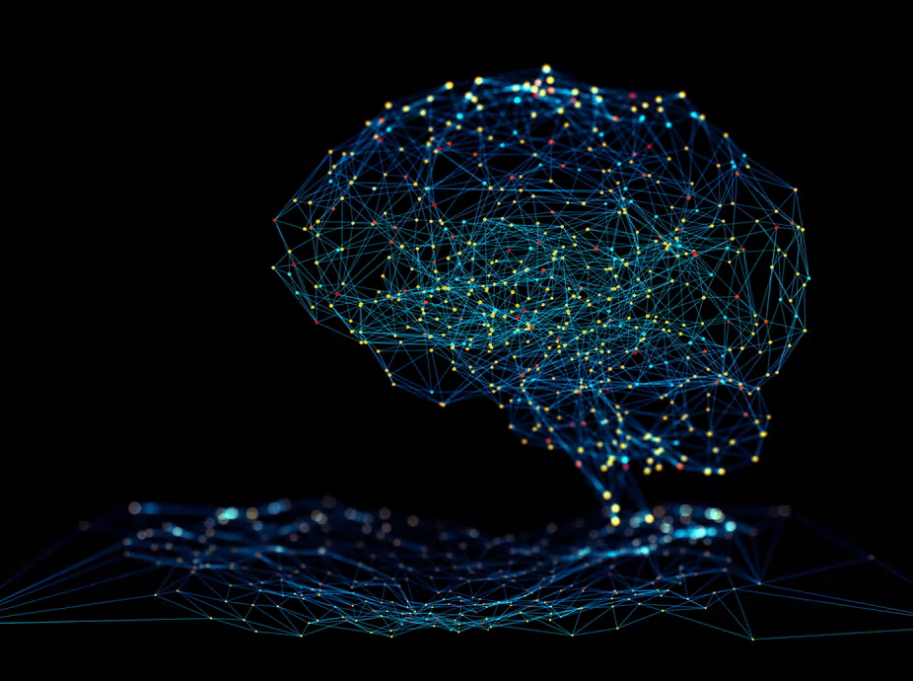
Thank You

